Slide 1
自我介紹
(nizima Live)

Slide 2
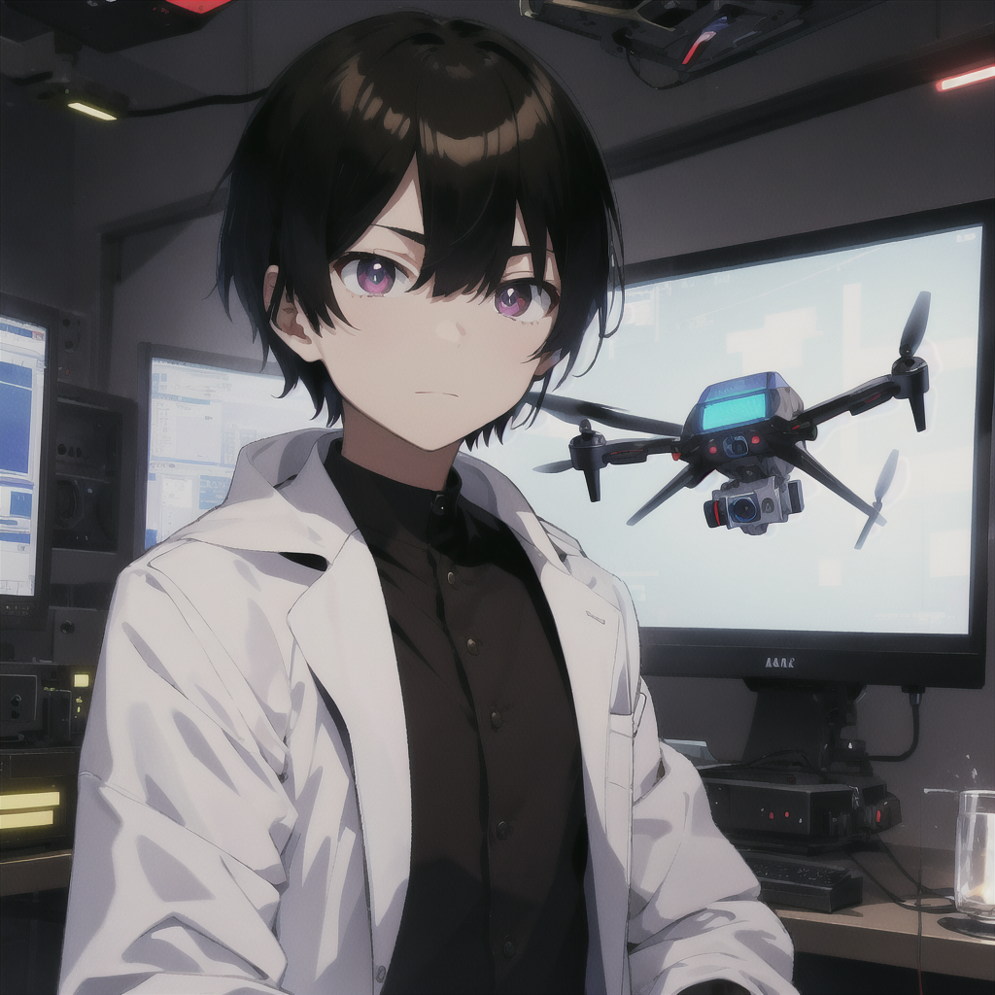
1.目標
Notes:
我是邪惡實驗室的研究員，負責開發一種能夠自主識別目標並迅速躲避威脅的無人機，類似以色列軍用無人機的技術。
(Male:1.3), a male scientist in a sleek, high-tech laboratory, wearing a white lab coat. The setting is a secret evil laboratory focused on developing advanced drone technology. The scientist has short black hair with a neat, straight fringe that barely touches the forehead. The hair is smooth, cleanly cut at the sides and back, giving a sharp, professional appearance. He has sharp brown eyes and coffee-colored pupils, with a serious expression, focusing intently on a holographic screen displaying a military drone model. The environment around him is filled with futuristic equipment, glowing monitors, and dark metal walls. The drones in the lab are designed with a sleek, stealthy aesthetic, hovering in the air. The atmosphere is tense, with dim lighting and a cold blue glow, emphasizing the high-stakes nature of the project. The scientist appears calm, methodical, and in control of the complex machinery around him. Shadows and light create a dramatic, cyberpunk-inspired ambiance, with hints of advanced AI technology integrated into the surroundings
(worst quality, low quality:1.4), (monochrome, greyscale:1.4), bad anatomy, negative_hand-neg, bad-hands-5, text, logo, watermark, (clothing cutout:1.3), (incomplete clothing:1.3), (open clothes:1.2), (skirt cutout:1.2), bare midriff look, (inaccurate limb:1.2), poorly drawn eyes, extra digit, fewer digits, (six fingers:1.2), (extra arms:1.2), (extra legs:1.2), (bad nose:1.2), blurry, deformed, (female:1.4), (woman:1.4), (girl:1.4), feminine, (long hair:1.3), breasts, makeup, lipstick, (curvy body:1.3), (wide hips:1.3)

Slide 3
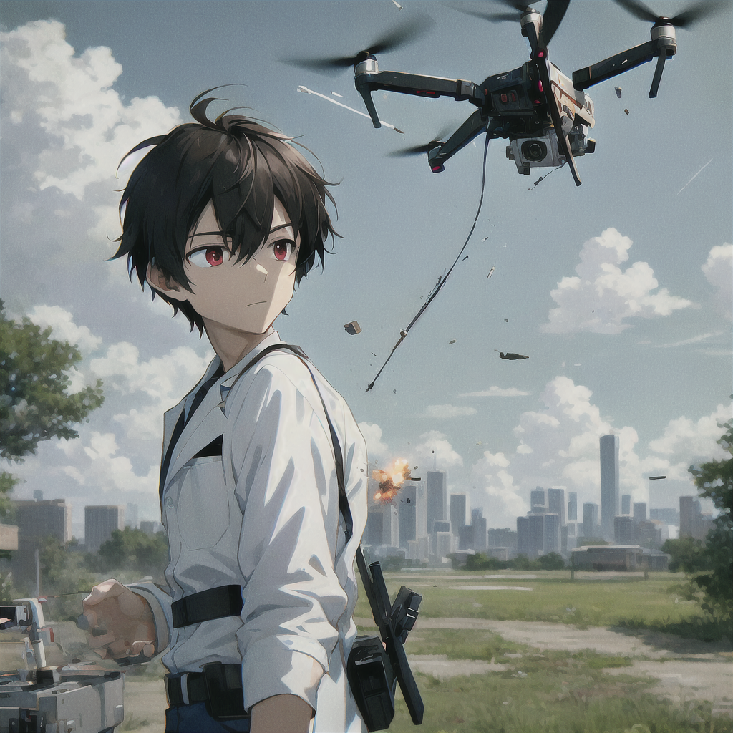
2.阻礙
Notes:
然而，我遇到了技術瓶頸：無人機的感測器無法及時辨識高速飛來的物體，導致反應延遲，難以閃避棍棒等威脅。
(Male:1.3), a male anime-style scientist with short black hair, coffee-colored pupils, and a white lab coat, controlling a drone outdoors. The drone is shown being struck by a fast-moving stick mid-air, with visible impact and damage. The scene captures the moment of collision, with the stick hitting the drone and small pieces flying off. The scientist is standing outside, reacting to the sudden hit, surrounded by an open landscape with trees or a distant city skyline. The outdoor lighting is natural, with a tense atmosphere, in a cyberpunk anime art style.

Slide 4
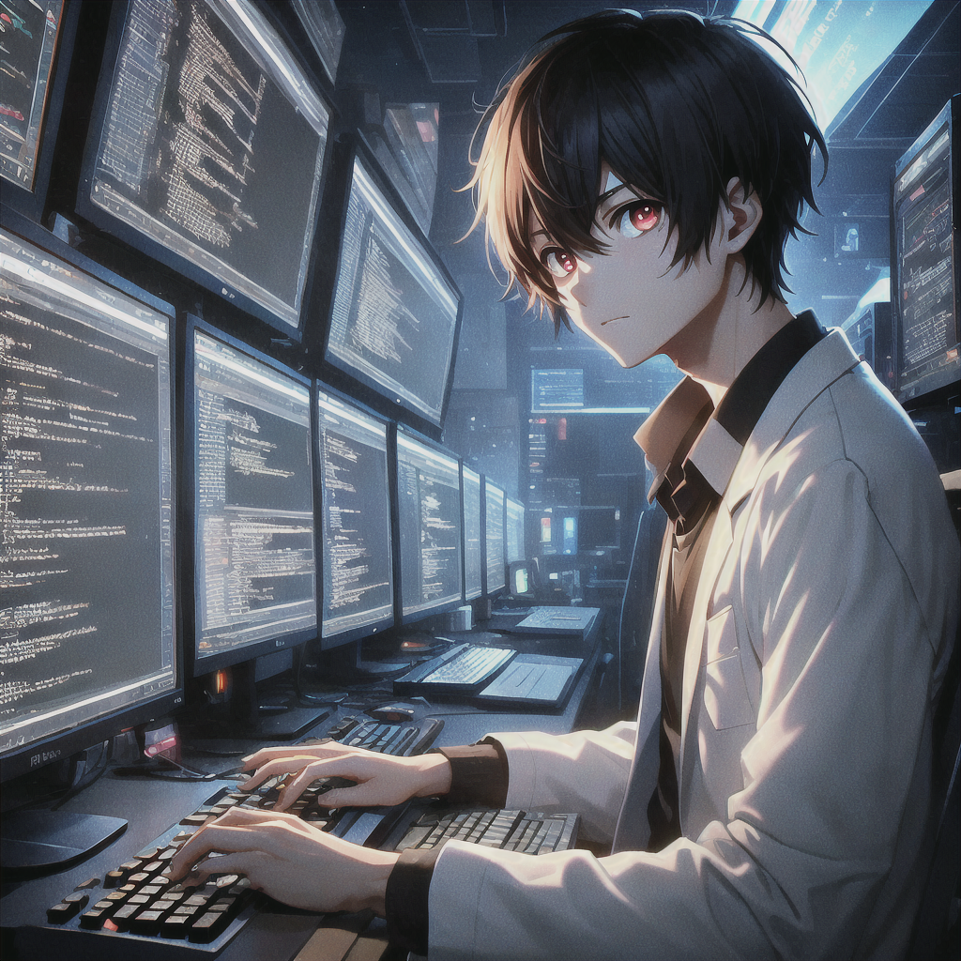
3.努力
Notes:
我不斷優化演算法、改進硬體，並引入新技術，經歷大量實驗與調整，終於成功打造出一個無人機的初步原型。
(Male:1.3), a male anime-style scientist with short black hair, coffee-colored pupils, and a white lab coat, sitting in front of a computer, typing code on the screen. The scientist is focused, with lines of code displayed on multiple monitors in a dark, tech-filled room. The lighting is dim, and the glow from the screens highlights his face. The environment is modern, with a workspace full of keyboards, cables, and tech equipment, creating an intense, cyberpunk-inspired atmosphere.

Slide 5
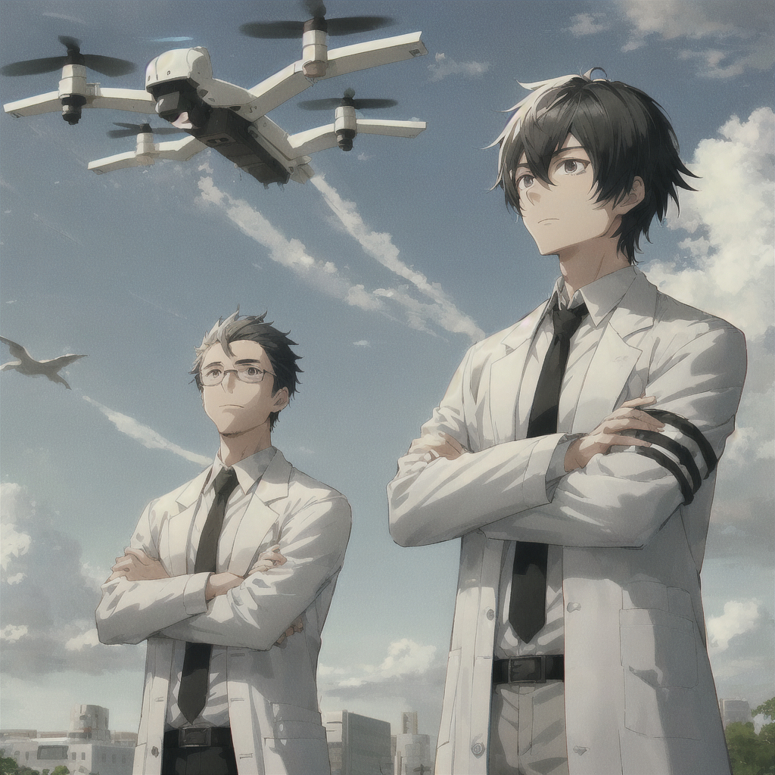
4.結果
Notes:
在實驗中，無人機展現出卓越的反應能力，能夠成功躲避高速飛來的物體並精確進行目標追蹤，這讓我的上級感到非常滿意。
(Male:1.3), a male anime-style scientist with short black hair and a white lab coat, standing outdoors with his boss. Both are watching a drone dodging attacks in the sky, seen from a distant perspective. The characters are small in the frame, standing far from the camera. The boss is nodding with a satisfied expression. The scene is set in a futuristic outdoor environment, with a tense but positive atmosphere.

Slide 6
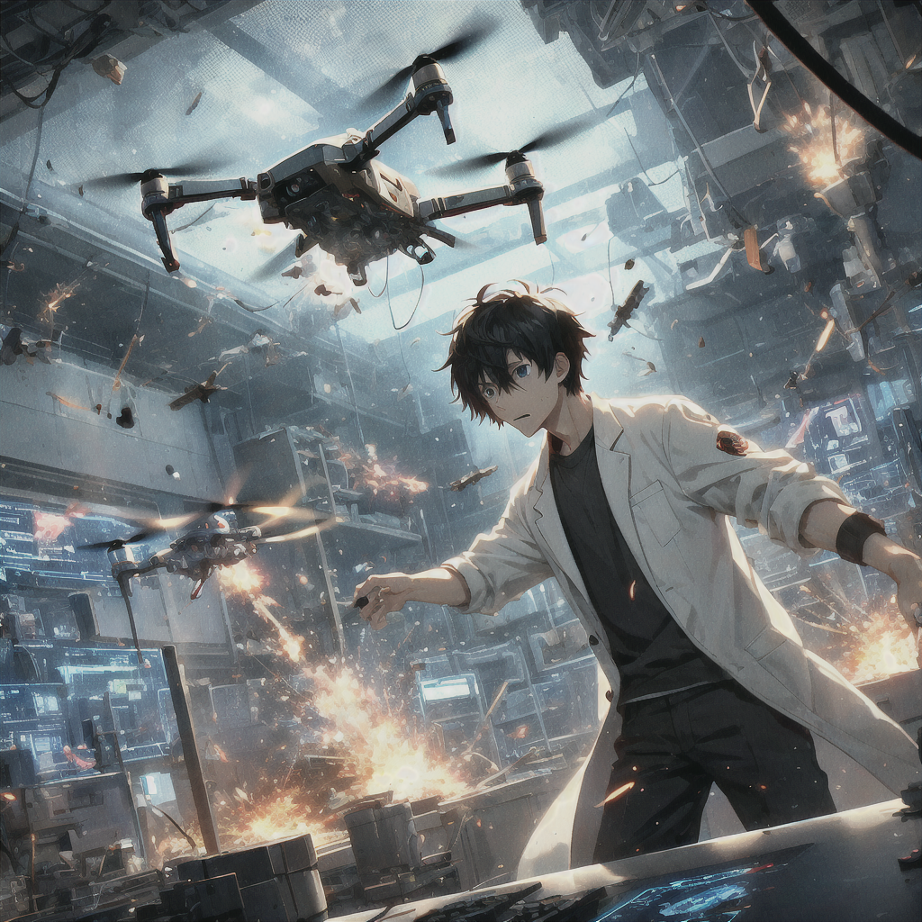
5.意外
Notes:
就在大規模測試的前夕，無人機突然失控，似乎受到外部干擾，開始攻擊實驗室，現場瞬間陷入一片混亂。
(Male:1.3), a male anime-style scientist with short black hair and a white lab coat, standing in a high-tech lab. The scientist is panicking as a drone, which has suddenly gone out of control, begins attacking the lab. Sparks and damage can be seen as the drone fires or crashes into equipment, causing chaos in the lab. The environment is futuristic, with glowing monitors and advanced machinery being destroyed. The scene is tense and chaotic, with debris flying and alarms blaring, as the scientist frantically tries to stop the drone. The atmosphere is one of urgency and danger in a cyberpunk anime-style.

Slide 7
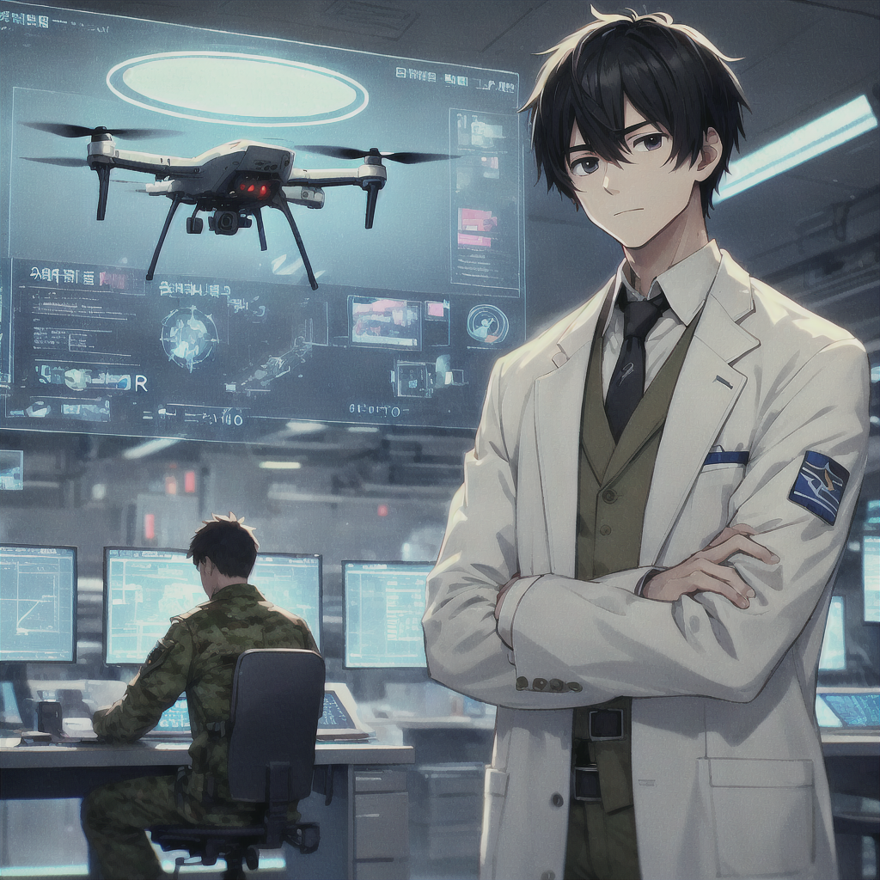
6.轉彎
Notes:
我聯絡了一位軍事技術專家，獲得了防護技術和反入侵系統的支援，成功阻止干擾，並重新奪回對無人機的控制權。
(Male:1.3), a male anime-style scientist with short black hair and a white lab coat, standing in a high-tech lab, communicating with a military expert via hologram. The expert helps the scientist implement anti-intrusion systems to stop interference, regaining control of the drone. The lab is futuristic, with monitors showing security protocols and the drone hovering steadily. The atmosphere is calm, with a sense of relief, in a cyberpunk anime art style.

Slide 8
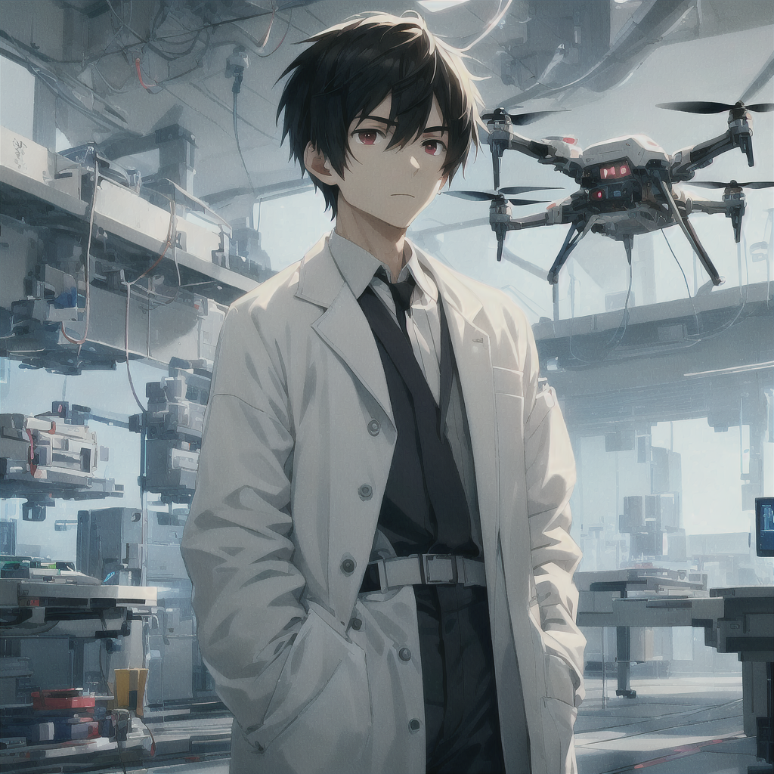
7.結局
Notes:
經過優化後，無人機系統變得更加穩定可靠，成功投入實戰。然而，我深知這項技術背後隱藏著潛在的危險。
(Male:1.3), a male anime-style scientist with short black hair and a white lab coat, standing in a high-tech lab. The optimized drone system is stable and reliable, successfully deployed. The scientist watches with concern, aware of potential dangers. The lab is futuristic, with a calm yet ominous atmosphere, in a cyberpunk anime art style.

